Slide 1
Rewired m6A methylation of promoter antisense RNAs in Alzheimer’s disease regulates gene expression
Benxia Hu Ph.D.
05/19/2025

Slide 2
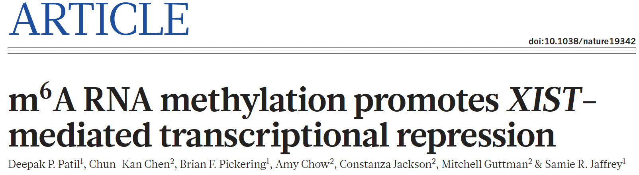
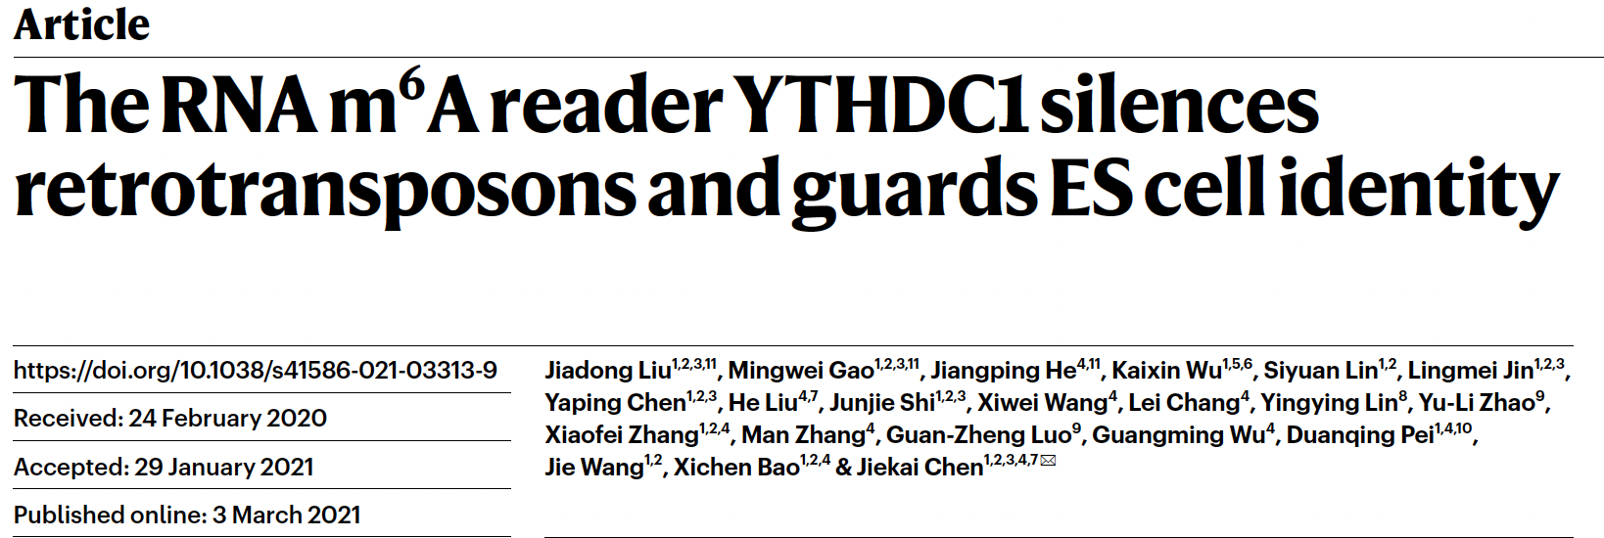
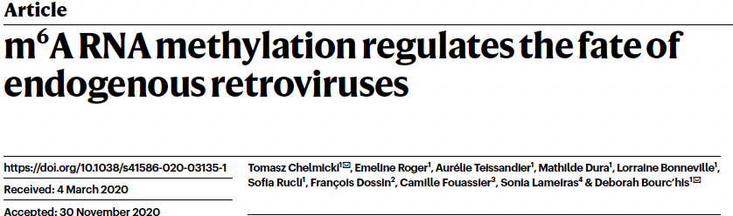
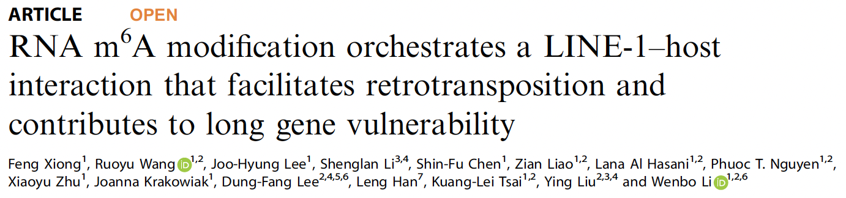
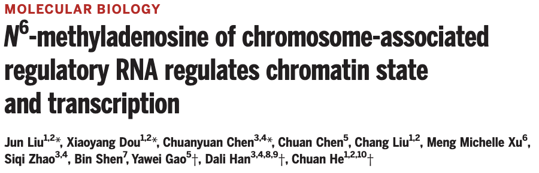
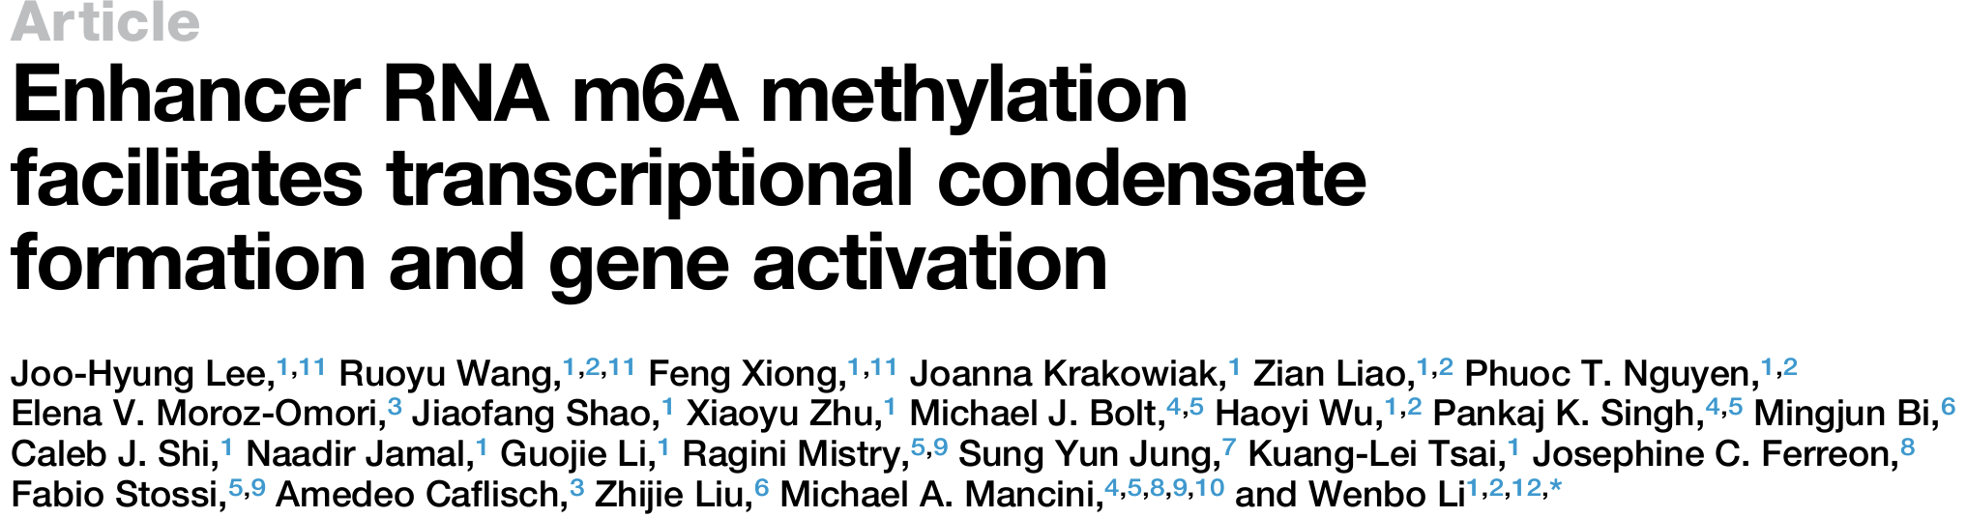
m6A methylation on ncRNAs regulates gene transcription

Slide 3
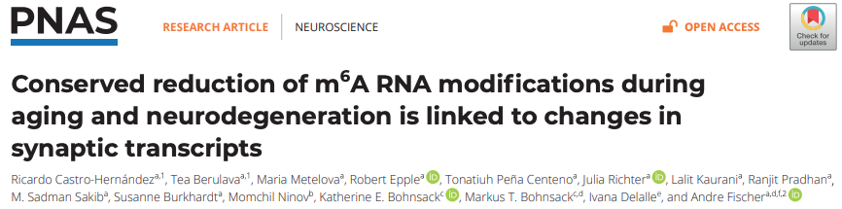
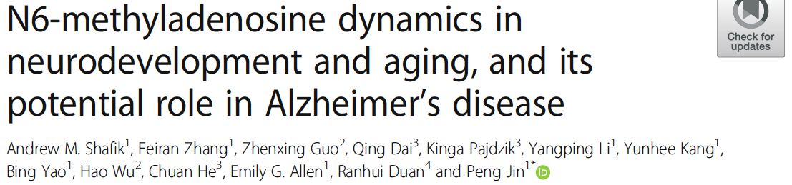
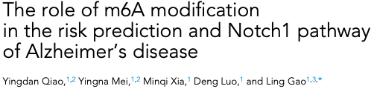
m6A methylation regulates mRNAs in AD brains and mouse model

Slide 4
ncRNA m6A has been poorly understood in AD

Slide 5
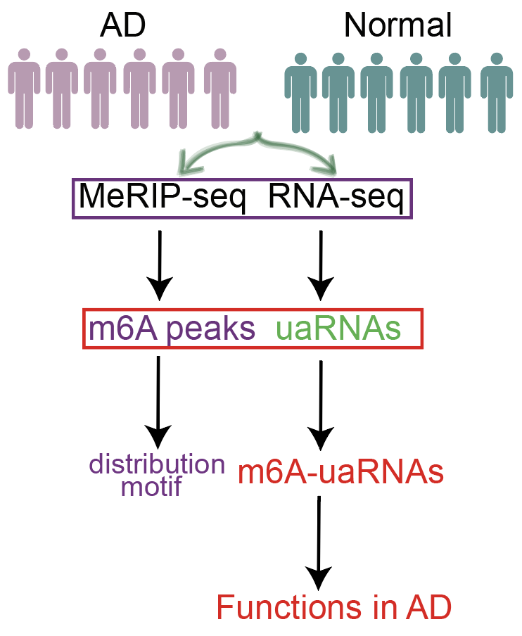
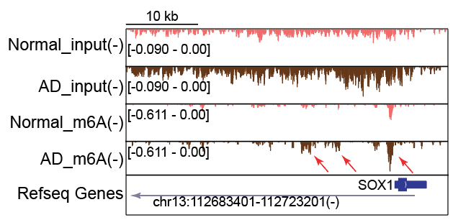
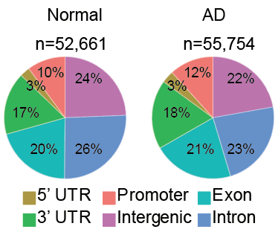
Many m6A peaks are on upstream antisense regions of promoters
A
C
B
m6A methylation on promoter regions
Experiments done by Dr. Feng Xiong

Slide 6
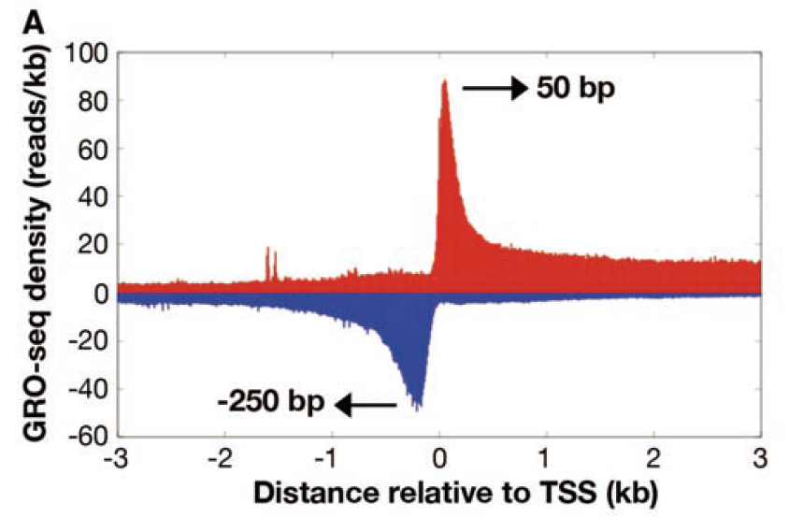
Promoter antisense RNA
mRNA
Seila et al., Science, 2008;
Core et al. Science, 2008;
Preker et al, Science, 2008;
He et al, Science, 2008;
promoter antisense RNA (paRNA)

Slide 7
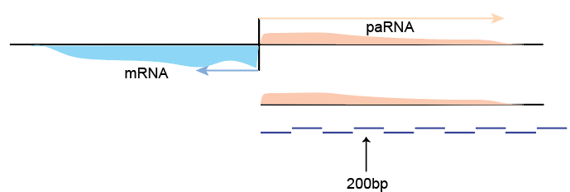
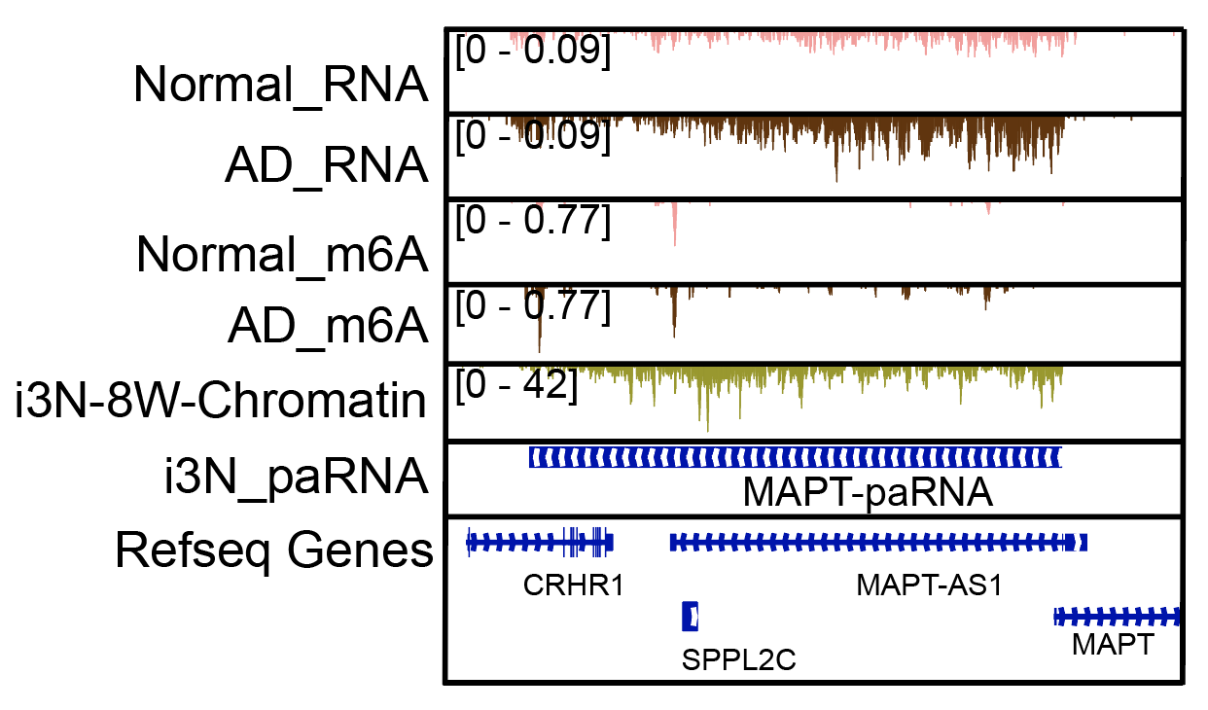
Hidden Markov model identifies paRNAs
A
B
Schwalb et al., Science, 2016
Shao et al., Mol Syst Biol., 2022

Slide 8
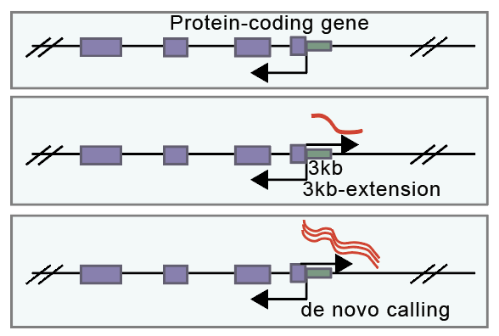
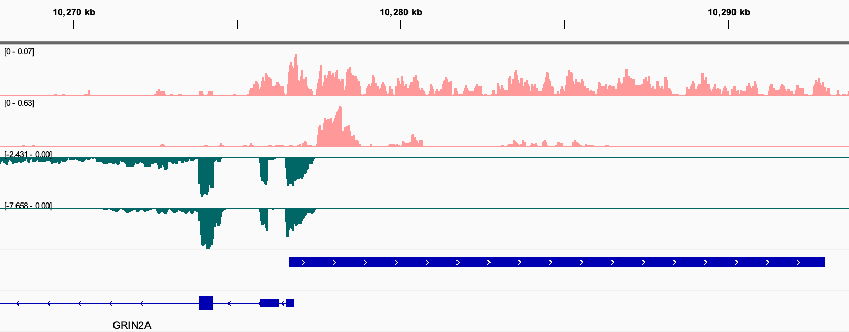
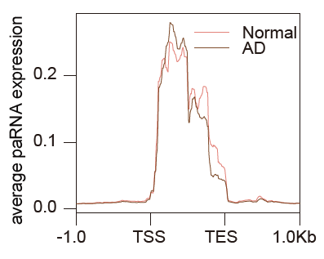
Identification of paRNAs in the human brains
A
C
AD-m6A(-)
RNA(+)
3,038 paRNAs
m6A(+)
RNA(-)
B
m6A(-)
GRIN2A-paRNA

Slide 9
What is the Role of m6A methylation on paRNA expression？

Slide 10
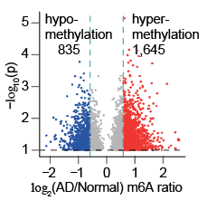
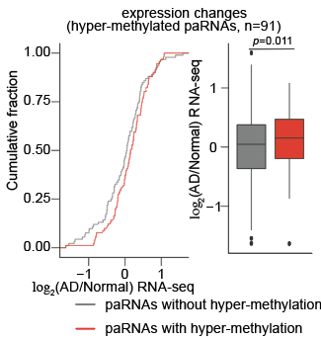
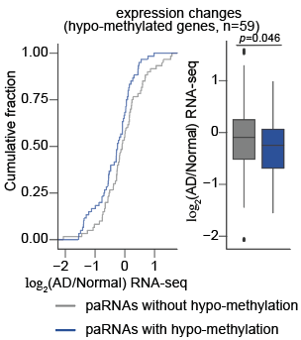
m6A methylation is positively correlated with paRNA expression
A
B
C

Slide 11
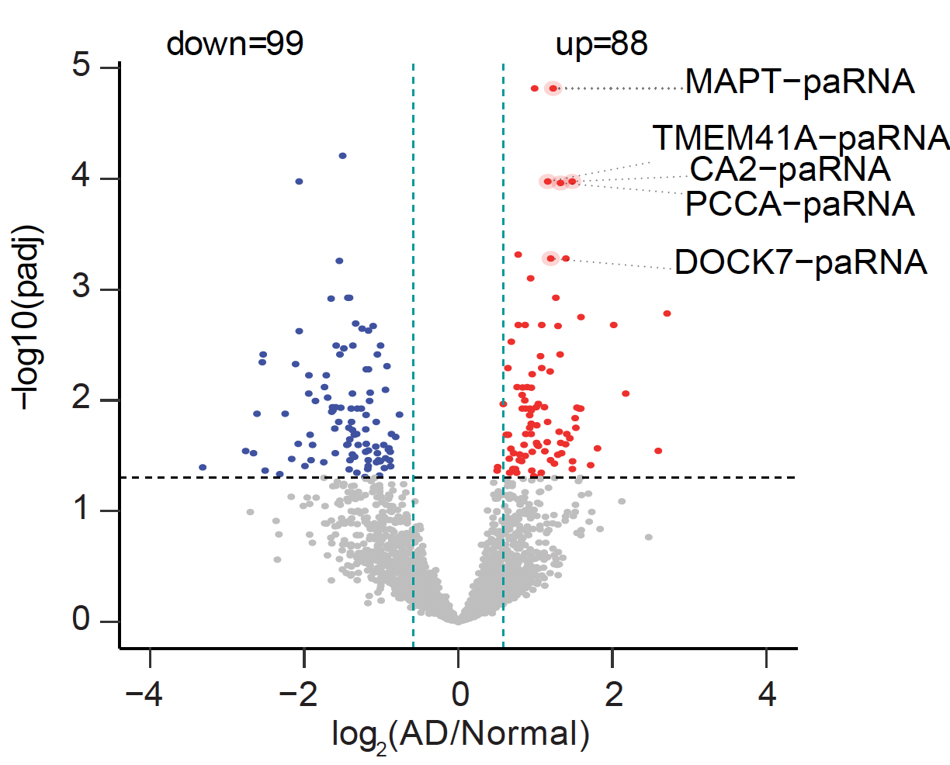
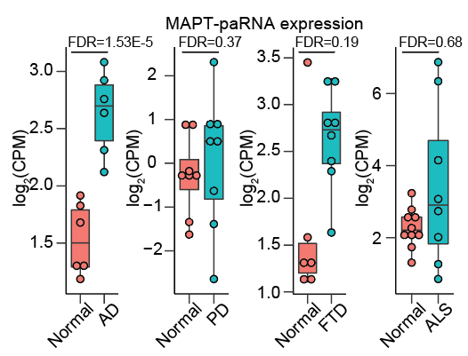
MAPT-paRNA was upregulated in AD
A
B
PD: Parkinson’s Disease
FTD: Frontotemporal Dementia
ALS: Amyotrophic Lateral Sclerosis

Slide 12
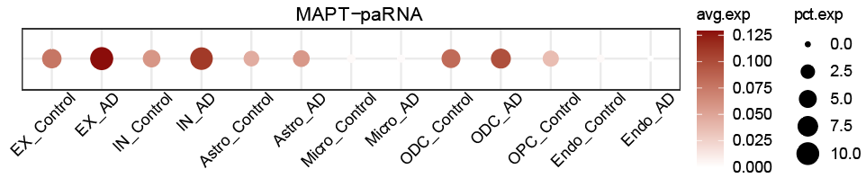
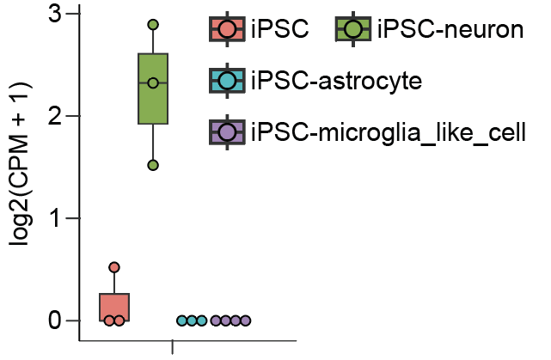
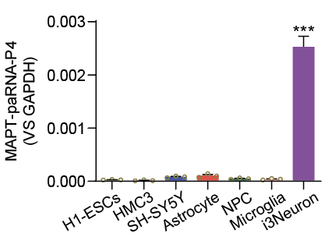
MAPT-paRNA was highly expressed in excitatory neurons
A
B
C
iPSC-derived neuron:
i3Neuron
MAPT-paRNA
qPCR done by Dr. Yuqiang Shi

Slide 13
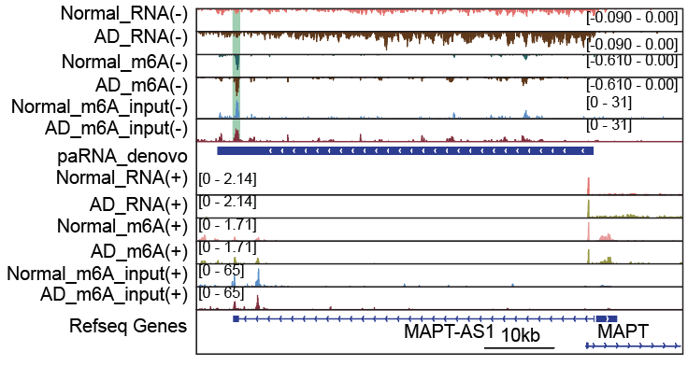
MAPT-paRNA gained m6A methylation in AD

Slide 14
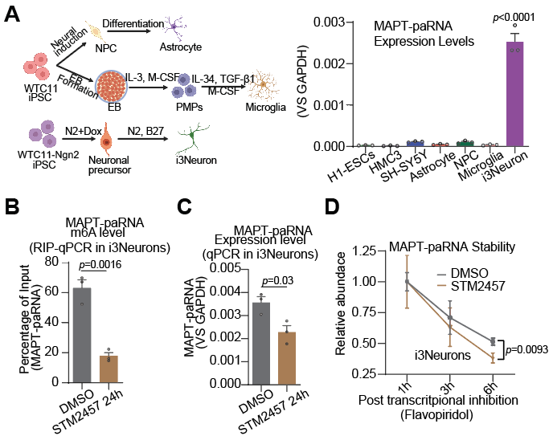
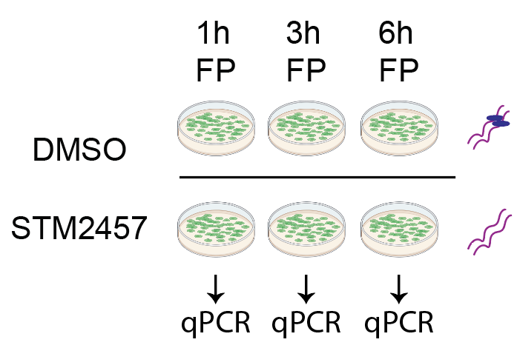

m6A methylation can stabilize MAPT-paRNA
A
C
B
B
Flavopiridol (FP) inactivates P-TEFb and blocks RNA Polymerase II Transcription.
Experiments done by Dr. Yuqiang Shi

Slide 15
What is the function of MAPT-paRNA in Alzheimer’s disease？

Slide 16
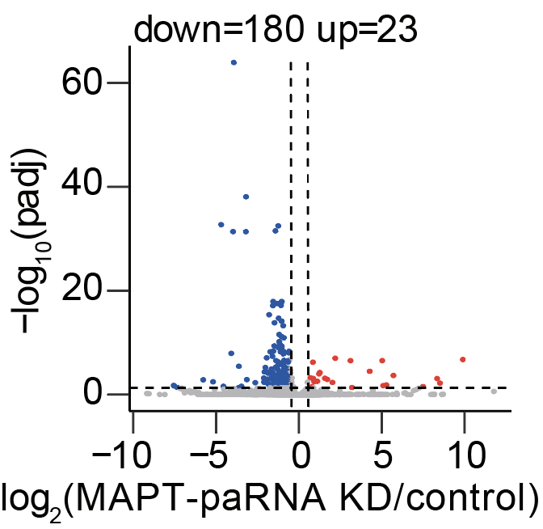
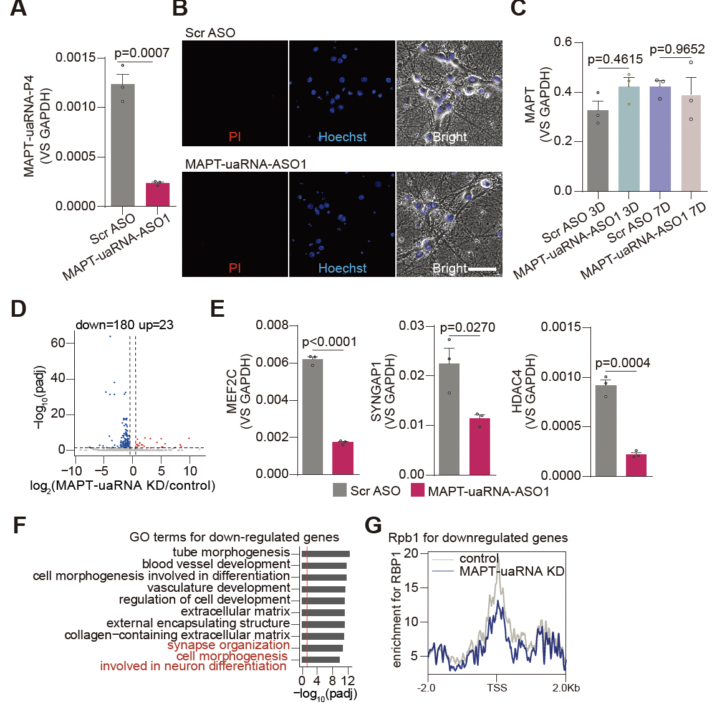
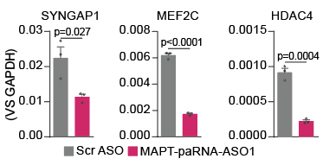
MAPT-paRNA modulates synapse
A
B
C
Experiments done by Dr. Yuqiang Shi

Slide 17
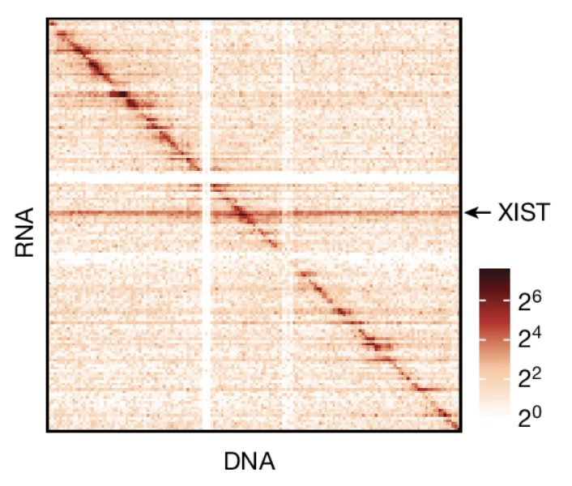
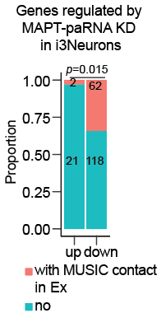
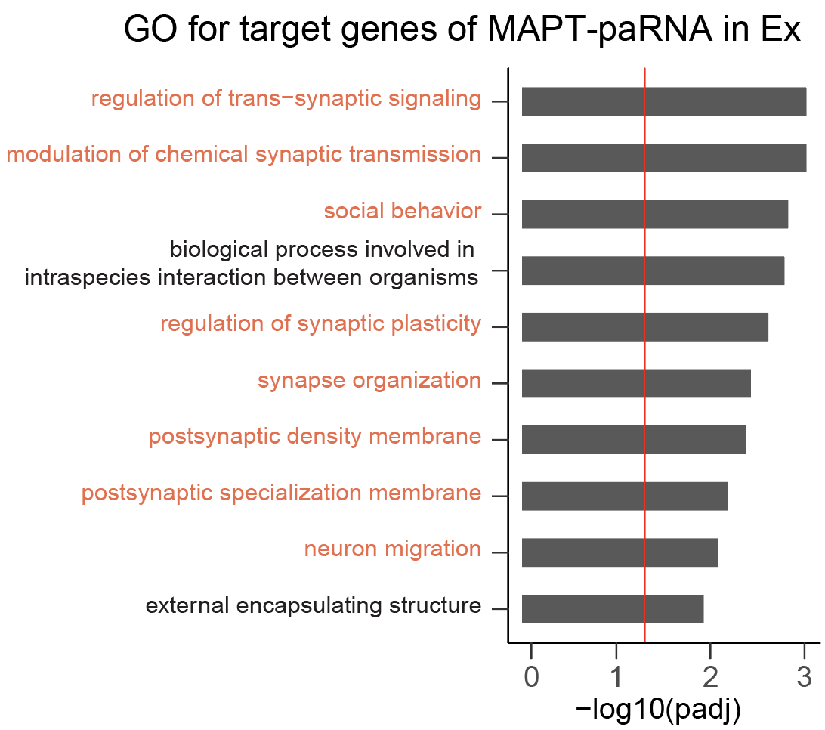
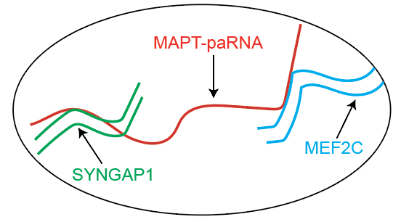
MAPT-paRNA can interact with its target genes
A
C
D
B
MUSIC can detect RNA-DNA interaction at single-cell level.

Slide 18
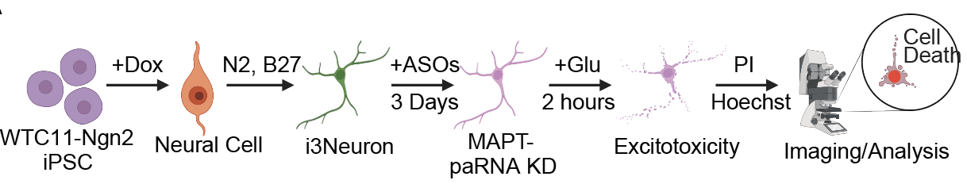
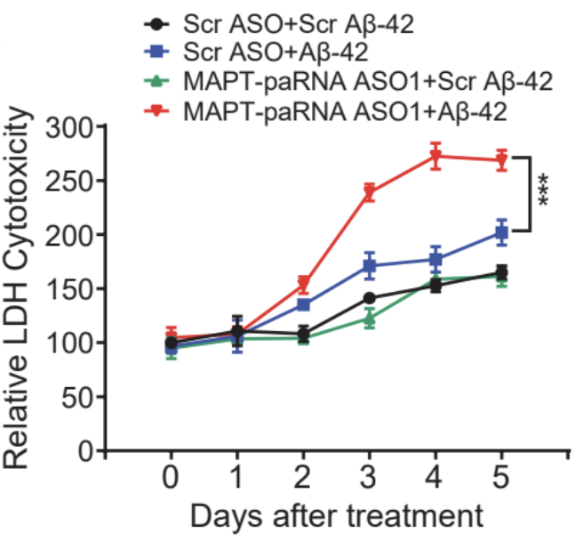
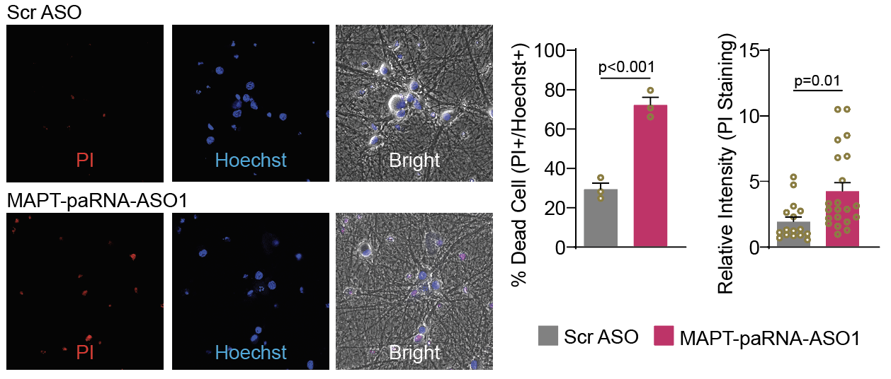
MAPT-paRNA can protect neurons in the presence of stress
A
D
B
C
Relative Cytotoxicity
Glu: Glutamate stimuates neurons
Experiments done by Dr. Yuqiang Shi

Slide 19
Conclusions
1. m6A methylation can stabilize MAPT-paRNA.
2. MAPT-paRNA regulates genes via RNA-DNA interactions.
3. MAPT-paRNA can protect neuron survival in AD.
Questions:
1. How does MAPT-paRNA regulate its target genes?
2. How is MAPT-paRNA upregulated in AD?

Slide 20
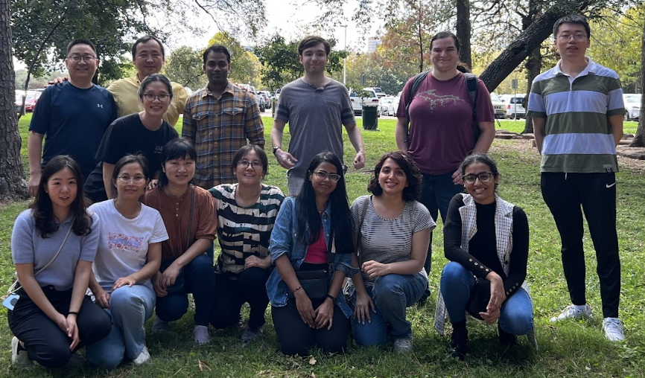



Acknowledge
Dr. Wenbo Li supervised this project.
Dr. Hui Zheng shared human brain samples.
Dr. Sheng Zhong shared MUSIC data.
Drs. Yuqiang Shi, Feng Xiong, Xiaoyu Zhu, and Xinzhao Wen.
Mr. Nathan Drolet and Mrs. Yi-ting Chen.
All Lab members

Slide 21
Thanks for your attention!

